Slide 1
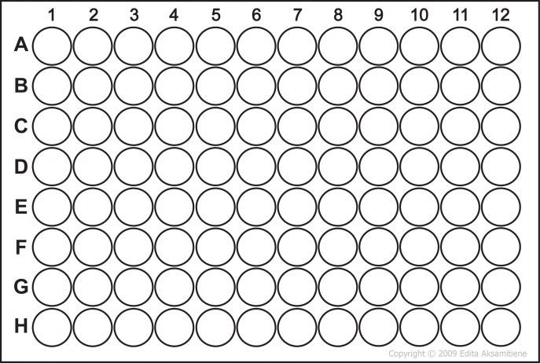
NHB 623950
COPD 436083
STANDARDS
CONTROL N3
CONTROL N3
-Only analyzed N3 transwell samples
0.1 MOI N3
0.1 MOI N3
0.05 MOI N2
0.05 MOI N2
0.05 MOI N3
0.05 MOI N3
0.01 MOI N2
0.01 MOI N2
0.01 MOI N3
0.01 MOI N3
BLANK

Slide 2
Results
Regression Type: Logistic - 5PL
Std. Curve: FI = 23.3701 + (87661.5 - 23.3701) / ((1 + (Conc / 4349.72)^-0.864848))^1.48915
FitProb. = 0.3643, ResVar. = 1.0099

Slide 3
Results
Regression Type: Logistic - 5PL
Std. Curve: FI = 20.6831 + (14585.1 - 20.6831) / ((1 + (Conc / 985.373)^-1.62408))^0.921757
FitProb. = 0.2489, ResVar. = 1.3906

Slide 4
Results
Regression Type: Logistic - 5PL
Std. Curve: FI = 27.5722 + (26636.4 - 27.5722) / ((1 + (Conc / 7112.31)^-1.0461))^1.31456
FitProb. = 0.7188, ResVar. = 0.3302

Slide 5
Results
Regression Type: Logistic - 5PL
Std. Curve: FI = 3.79244 + (25545.4 - 3.79244) / ((1 + (Conc / 4471.27)^-1.65034))^0.812267
FitProb. = 0.2083, ResVar. = 1.5688

Slide 6
Results
Regression Type: Logistic - 5PL
Std. Curve: FI = 40.6089 + (94192.5 - 40.6089) / ((1 + (Conc / 2632.26)^-1.14369))^1.0967
FitProb. = 0.8383, ResVar. = 0.1763

Slide 7
Results
Regression Type: Logistic - 5PL
Std. Curve: FI = 28.6611 + (118373 - 28.6611) / ((1 + (Conc / 2932.21)^-0.524779))^2.25616
FitProb. = 0.4939, ResVar. = 0.7055

Slide 8
Results
Regression Type: Logistic - 5PL
Std. Curve: FI = 51.7536 + (122446 - 51.7536) / ((1 + (Conc / 170.16)^-0.663036))^2.44377
FitProb. = 0.5291, ResVar. = 0.6365

Slide 9
Results
Regression Type: Logistic - 5PL
Std. Curve: FI = -169.314 + (102736 + 169.314) / ((1 + (Conc / 1447.13)^-0.848202))^1.00965
FitProb. = 0.9873, ResVar. = 0.0128

Slide 10
Results
Regression Type: Logistic - 5PL
Std. Curve: FI = 355.787 + (25190.8 - 355.787) / ((1 + (Conc / 793.598)^-0.888444))^1.51918
FitProb. = 0.1889, ResVar. = 1.6668

Slide 11
Results
Regression Type: Logistic - 5PL
Std. Curve: FI = 14.4773 + (5250.28 - 14.4773) / ((1 + (Conc / 8324.64)^-1.5175))^0.687266
FitProb. = 0.0047, ResVar. = 5.3561

